Slide 1
Sales Call Activity Optimization

Slide 2
Executive Summary
PROBLEM OVERVIEW
OBJECTIVE & OPPORTUNITY
APPROACH
Portuguese banking institution wants to optimize their sales calls activity for term deposit sales done via phone marketing campaigns
Current sales conversion rate:
9.84%
Analyze the current sales call activity to better isolate customer segments having a higher propensity of buying the term deposit
Create a reactive system to rank new potential customers based on their propensity to buy the term deposits
Analyze the current sales conversion activity in terms of:
Age
Jobs
Married status
Call volume
Create a reactive system to rank new customers:
Compare different model performance
Quantify the percentage of customer segment to reach out
*Current sales conversion rate = Total number of conversions observed (3933) / Total number of calls made (39,944)
Notes:
Some changes. Go

Slide 3
What Do We Capture Currently
Call attribute data
Customer demographic data
Call day / month
Call duration
Campaign number
Call outcome
Call conversion
Records whether the customer finally bought the deposit or not
Age
Job
Education level
Married status
Loan status
Default history
Balance
Mode of Contact
Current date range captured: 7th Jan - 30th Dec
Total distinct calls captured & customers: 39,944
*Distinct calls are based on the assumption that a person is called once
Notes:
Some changes. Go

Slide 4
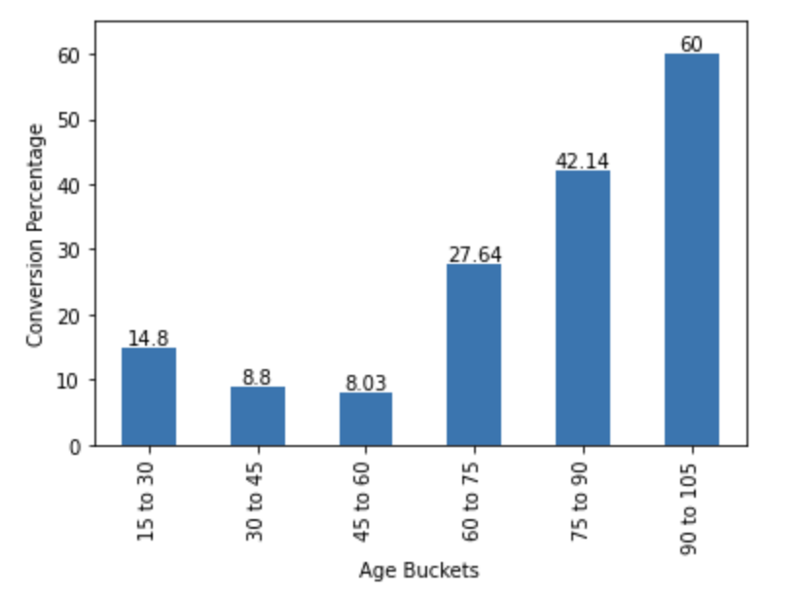
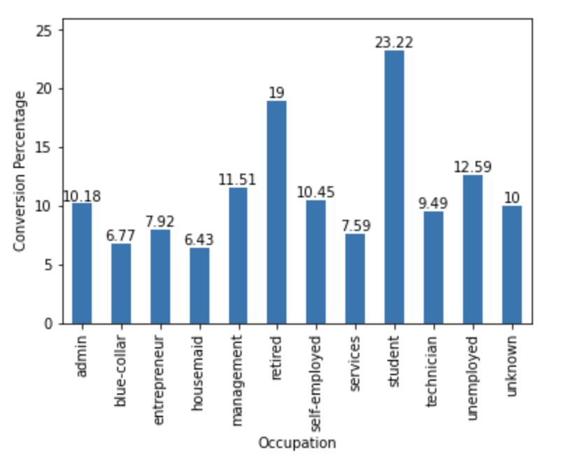
Old aged customers have higher conversion rates as compared to younger customers
Conversion rate across age buckets
Conversion rate across occupations
Old aged customers (60+) have a much higher conversion rate as compared to younger customers.
The highest conversion rates can be seen across 75 - 90 and 90 - 105 age bucket
A similar high conversion rate trend can be seen across the retired occupational demographic
*Conversion percentage = # conversions observed in the bucket/ Total number of calls made in the bucket
Notes:
Some changes. Go

Slide 5
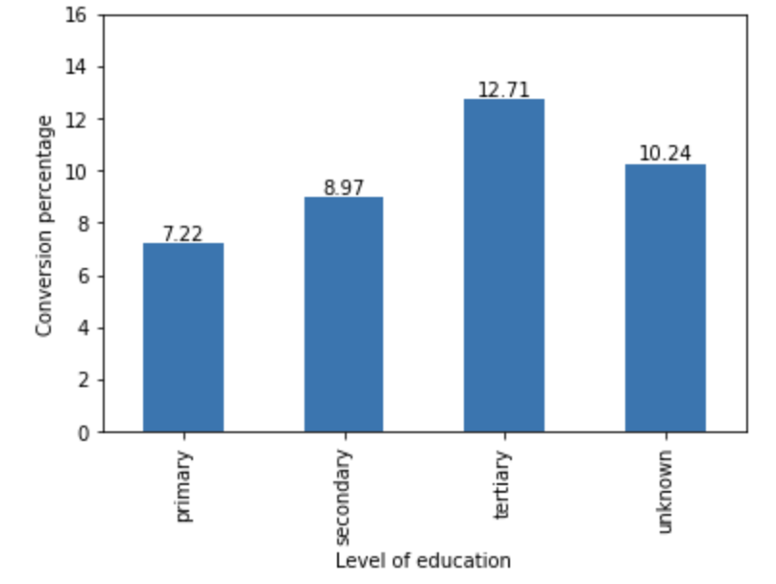

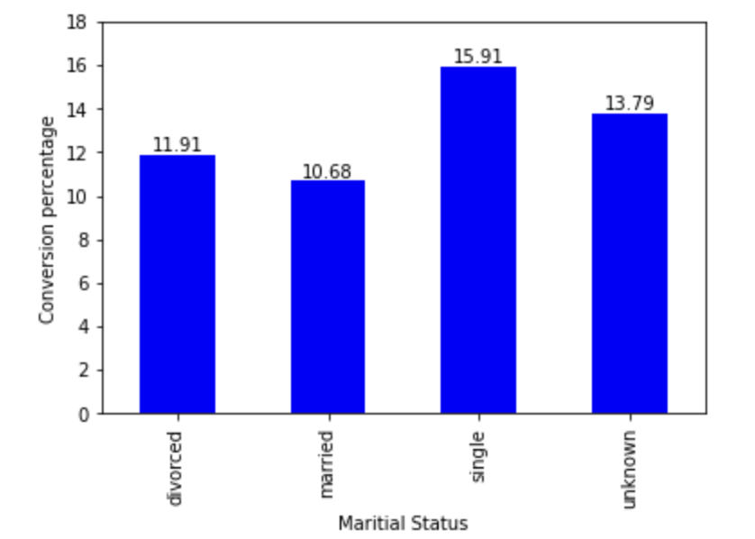
Higher Conversion Rates Can be seen as the Level of Education Increases
Distribution of conversion rate across education levels
A strong positive correlation can be seen between the conversion rates and the level of education.
Within the tertiary educated, single people have the highest propensity to buy the term deposits
Distribution of conversion rate across marital status within tertiary educated
*Conversion percentage= Total number of conversions observed / Total number of calls made in the bucket
*2,167 customers education level is unknown
*11,428 customers have tertiary level of education
Notes:
Maybe run a anova too

Slide 6
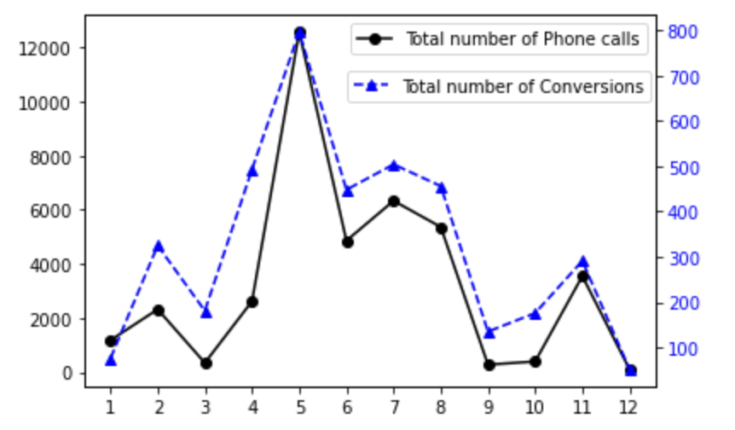
Higher Conversion Rates Can Be Seen as the Call Volume Increases
A strong correlation can be seen between the call volume and the number of conversions.
Call volume peaks in the month of May followed by a dip in the months of July, August, and September.
A similar peak can be seen in the total number of conversion for the month of may followed a dip in the next couple of months
Number of phone calls & conversions X Month:
Number of phone calls
Number of conversions
Month
Notes:
Some changes. Go

Slide 7
Reactive Model to Rank Potential Customers
Model Pipeline
Models
Results
Captures 80% of potential customers in the test set**
0.93 probability of placing a positive point ahead than a randomly chosen point
XG Boost Model
Random Forest Model
Captures 68% of potential customers in the test set**
0.93 probability of placing a positive point ahead than a randomly chosen point
Call Attribute Data
Customer Attribute Data
Input Feature vectors
Feature
Transformation & engineering
Logistic Regression Model
Captures 52% of potential customers in the test set**
0.58 probability of placing a positive point ahead than a randomly chosen point
*During feature transformation
categorical features are converted using one hot encoders / label encoding
NA / missing values are imputed / dropped based on the column definition
**At a threshold probability of 0.67
Notes:
761 people who bought the product in test set

Slide 8
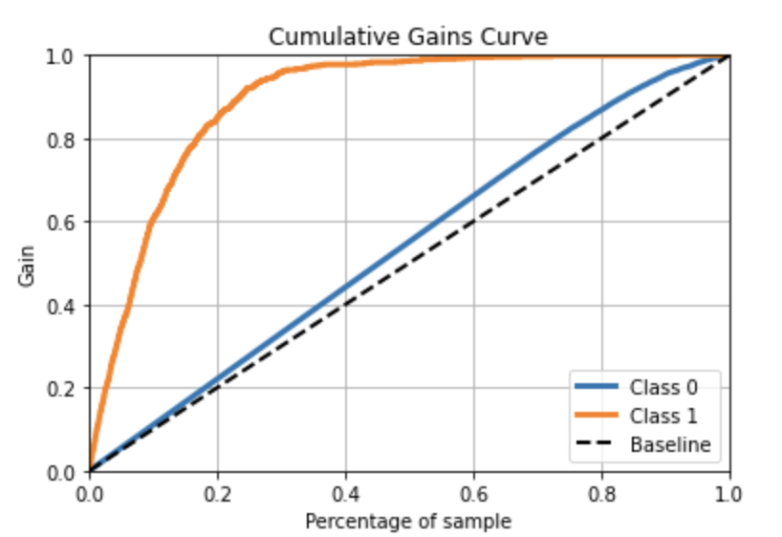
Percentage of Population to Reach Out
XG Boost cumulative gains curve:
Post XG Boost model prediction we can expect a response rate of 97% - 98% of overall responses in test set, by calling 40% - 60% of our test population, bringing down the overall required call volume
By leveraging the cost of each call and the profit return from each term deposit sale an optimal sample percentage can be determined.
*Class 1 customers who bought the term deposit
* Class 0 customers who did not buy the term deposit
*Total customers in test set: 7,989
* Overall responses in test set: 761
Notes:
We do not have to call all customers now the model is able to rank the potential customers ahead so even in 40% of our test sample population we capture 97% of our potential customers. This is where building a model is helping

Slide 9
Recommendations
Immediate Scope:
Shift the focus to call more old age customers (60+) as they have a higher propensity to buy term deposits.
If possible increase call volume as jump in call volume has a direct impact on number of conversion.
Call people having higher level of education as they tend to buy more term deposits.
Post XG Boost deployment:
Based on call cost, staff availability, and revenue generated from each term deposit sales reach out to a percentage of population to maximize overall revenue.
Perform batch prediction to classify new customers as to whether they would buy term deposits or not.
Notes:
Some changes. Go

Slide 10
Future Enhancements:
Model enhancements
Implement stacking architecture to further boost classification performance
Leverage models such as feed forward neural networks
Connect with business to work out cost per call rate and profit generated from each term deposit sale
Capture more customer features
Past spending
Gender
Location
Credit score
Capture more call features
Call sentiment
Call engagement
Outgoing call time
Notes:
Some changes. Go

Slide 11
Thank you
Notes:
Some changes. Go

